Slide 1
Vector Databases
and ANN algorithm

Slide 2
Keyword search vs Semantic search
exact term matching
“Top smartphones on the market…”
“Smartphone industry struggles…”
synonyms and other similar/related terms
“Using a cell phone in Spain…”
“Mobile device usage on the rise…”

Slide 3
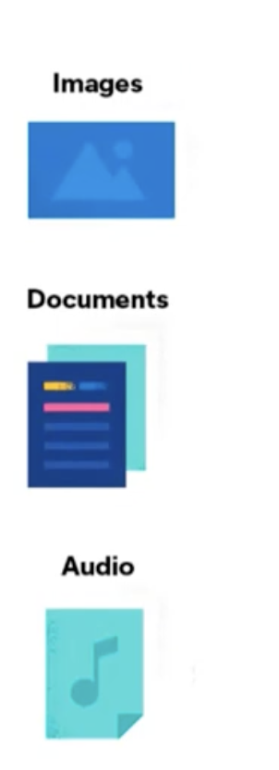

Slide 4
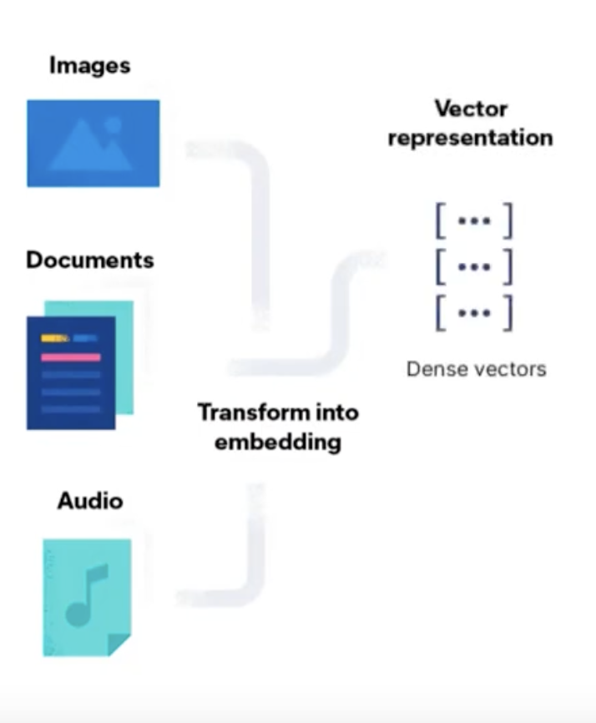

Slide 5
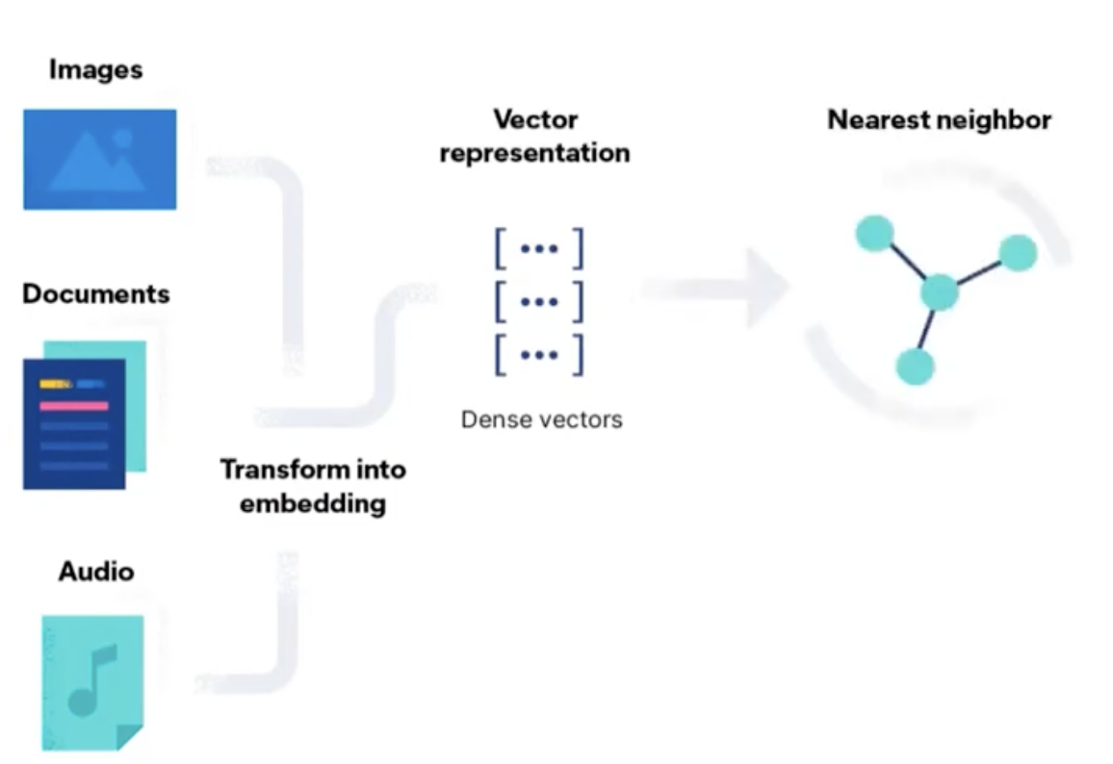

Slide 6
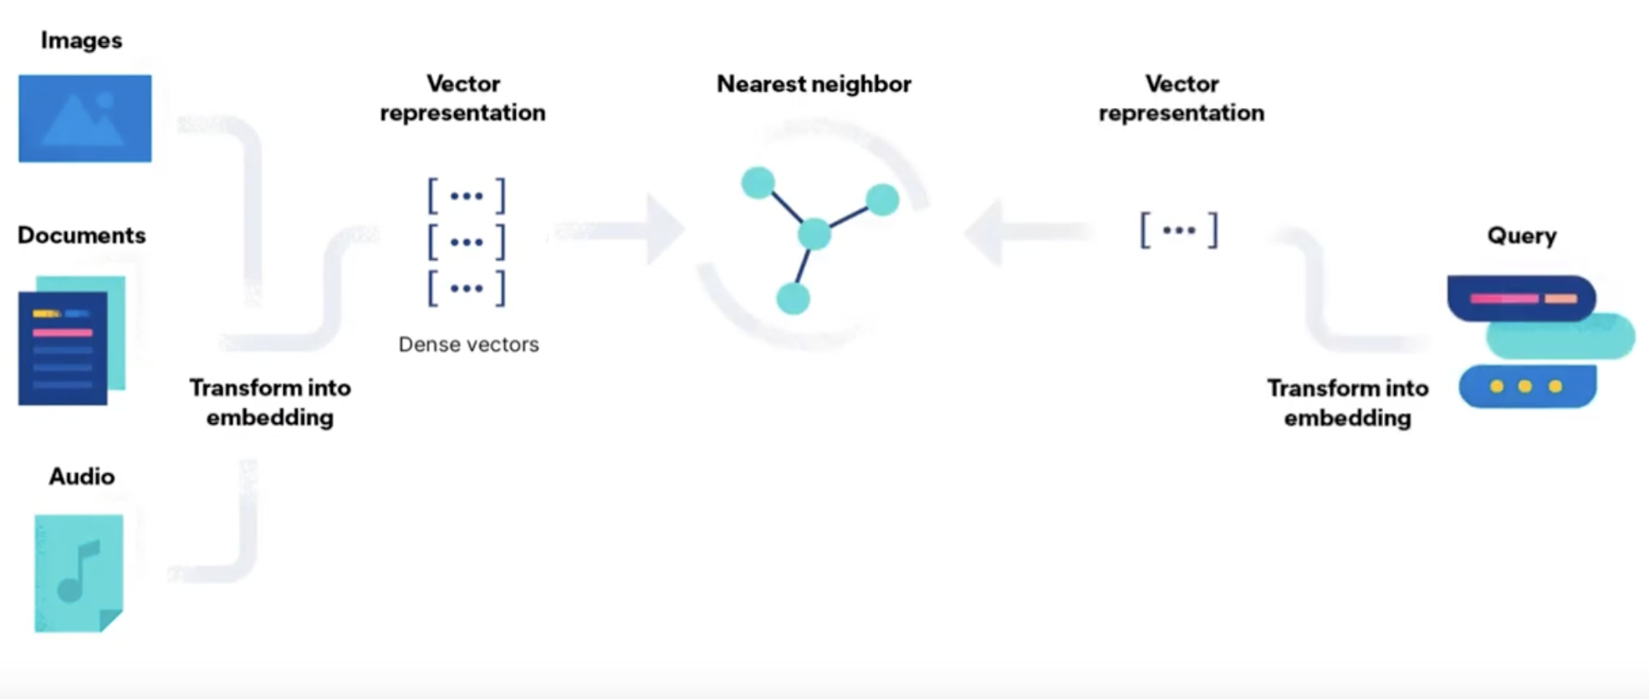

Slide 7
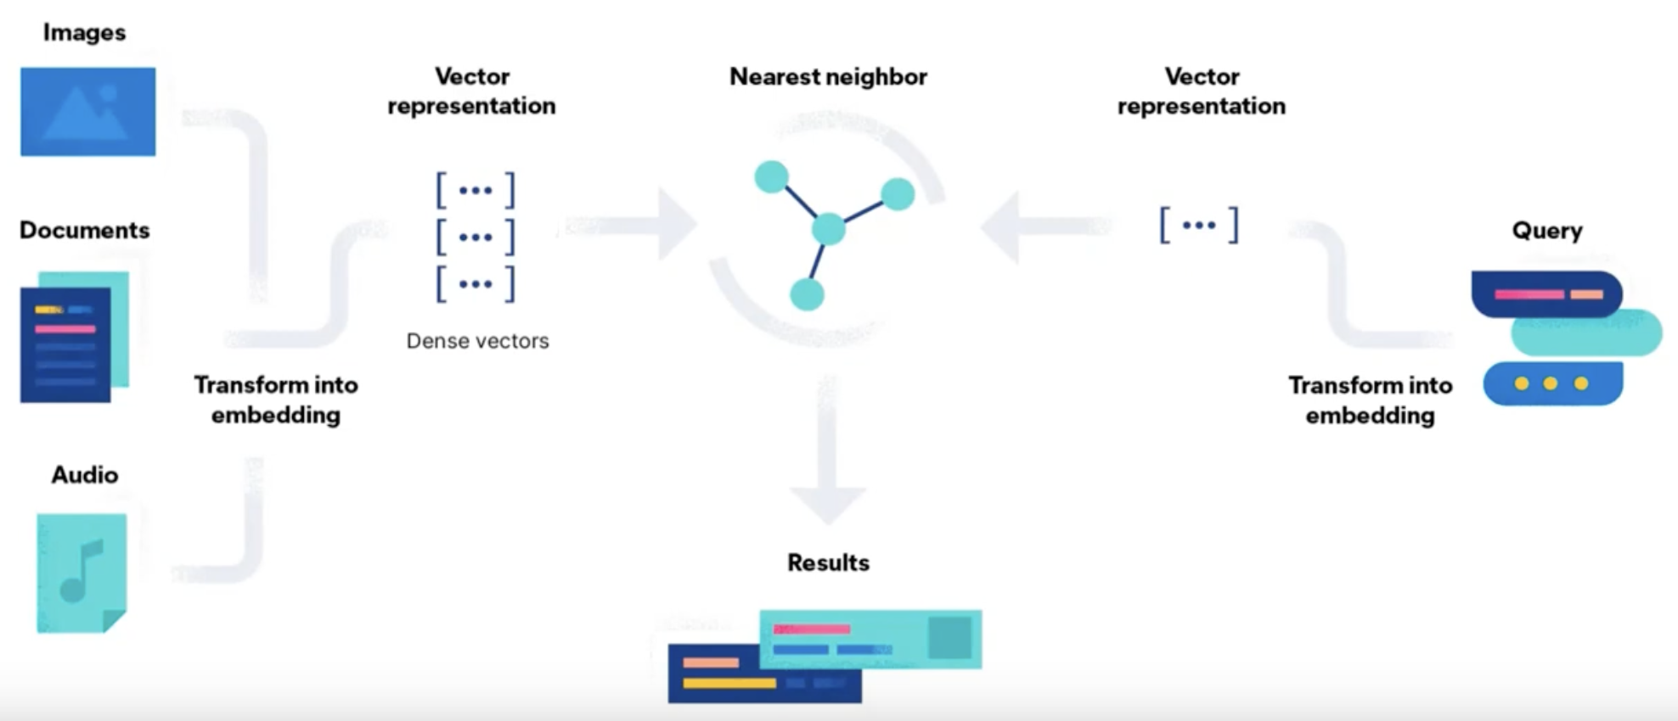

Slide 8
Semantic search is
Vector search

Slide 9
K Nearest Neighbour
Exhaustive, brute-force approach
Measure distance from query and all other vectors
Sort distances
Return top K results

Slide 10
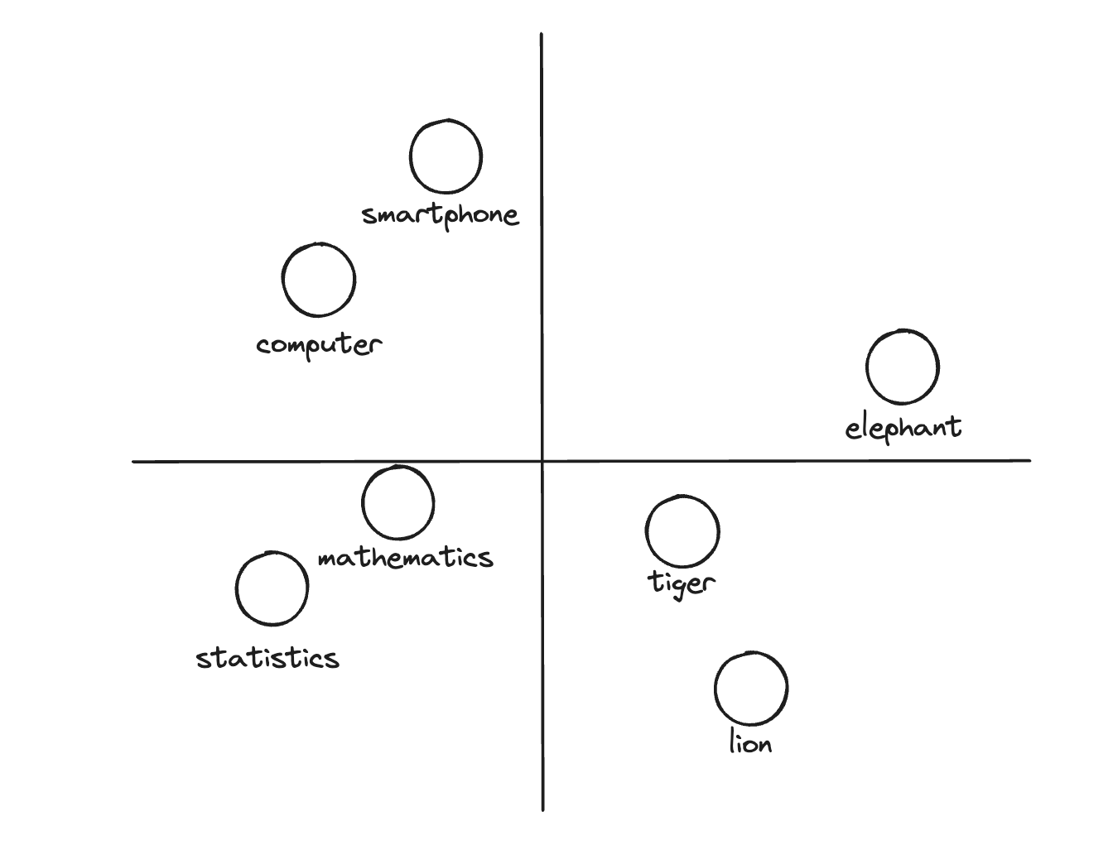

Slide 11
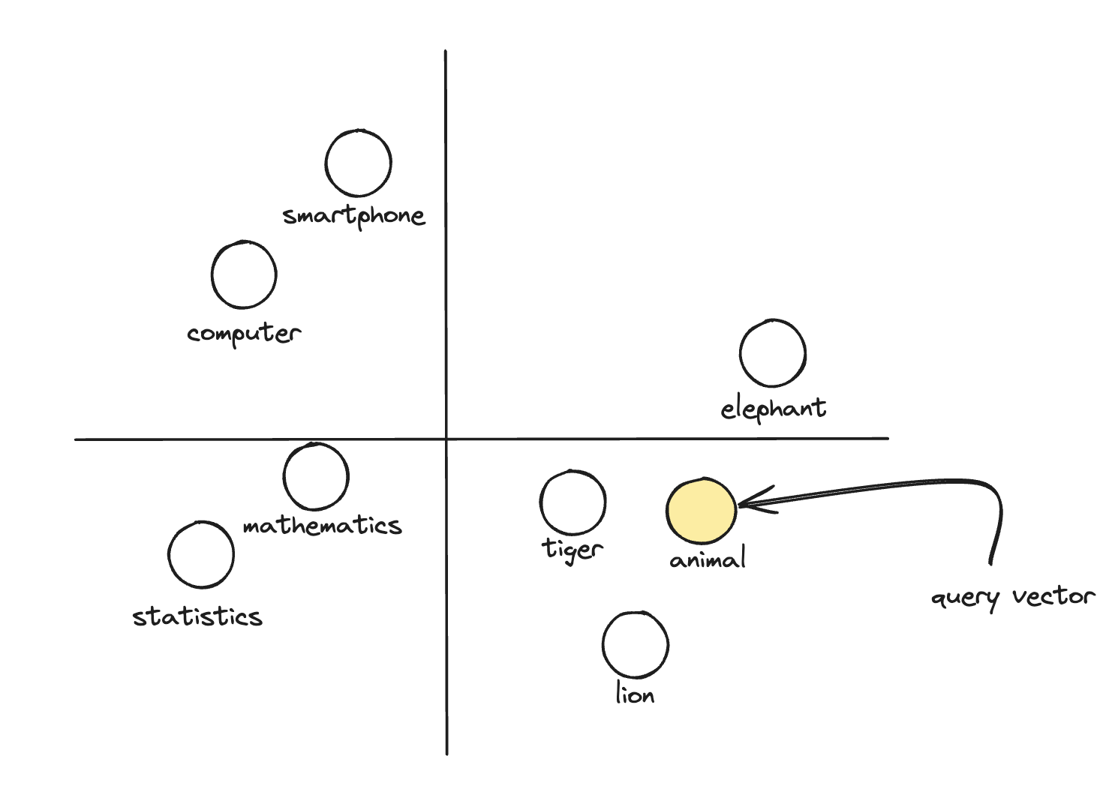

Slide 12
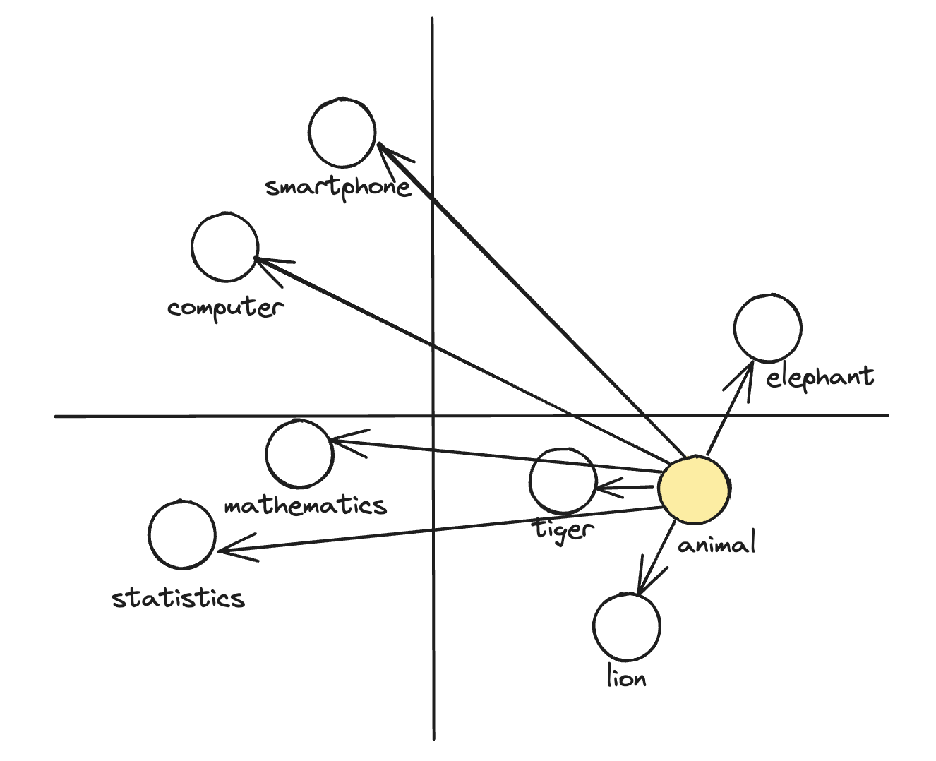

Slide 13
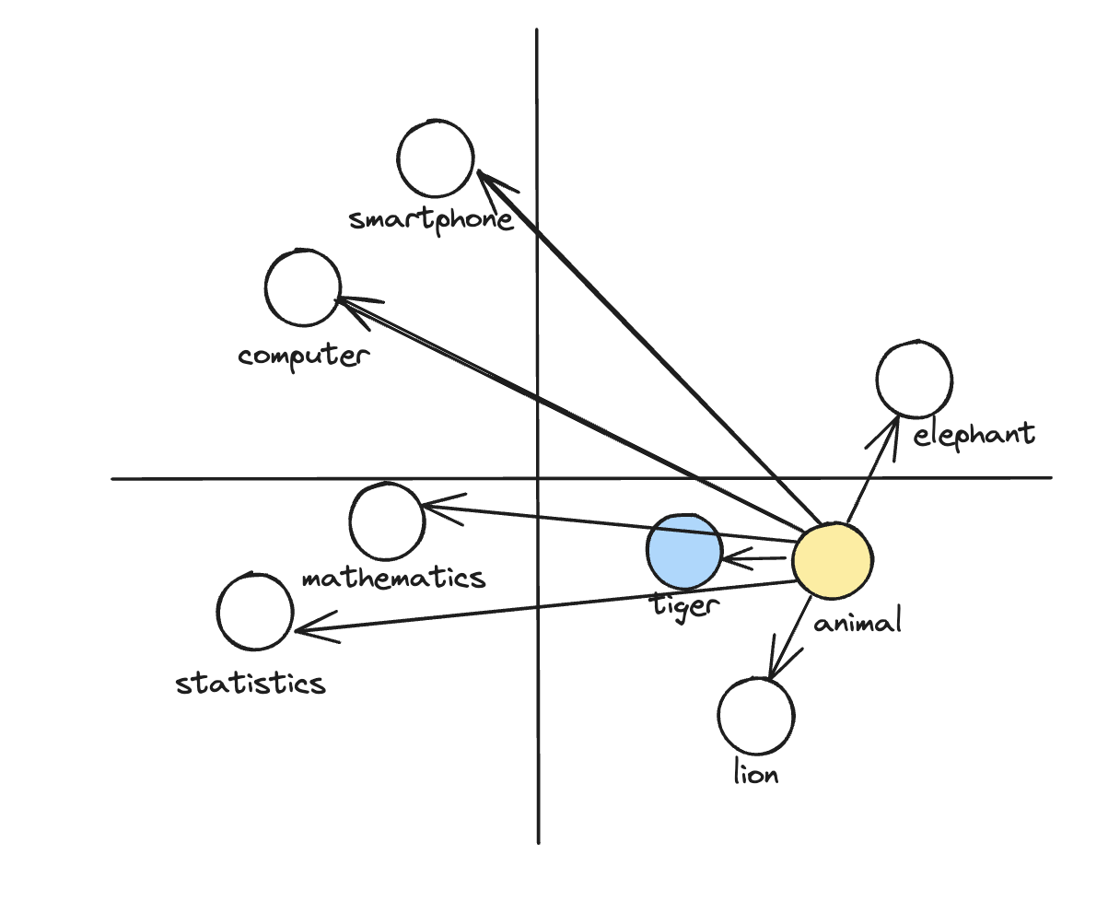

Slide 14
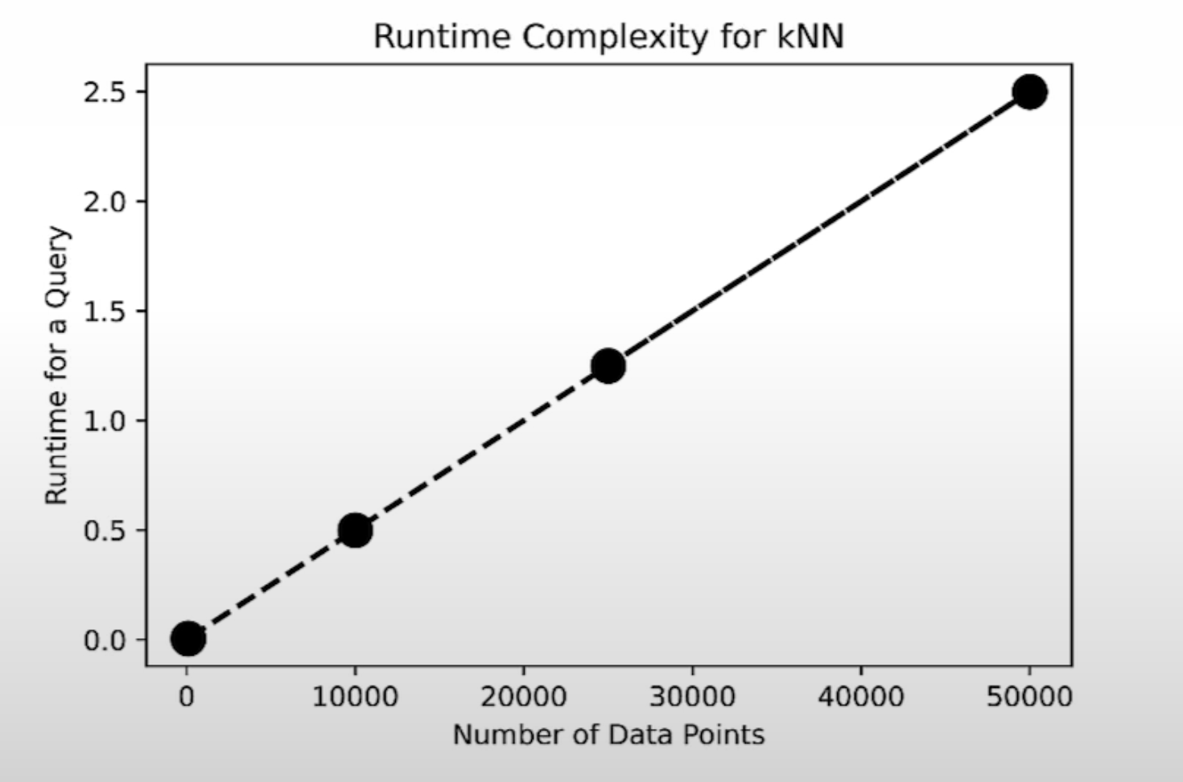
Performance
Number of dimension ~1000
Number of vectors ~millions
Typical query latency ~seconds

Slide 15
Trade off accuracy
for performance

Slide 16
Approximate Nearest Neighbour
Preprocess data into efficient index
Speed up search using index

Slide 17
Approximate Nearest Neighbour
Tree-based algorithm (ANNOY)
Locality sensitive hashing
Product Quantization
Inverted File Index
Proximity Graph (Hierarchical Navigable Small World)

Slide 18
Navigable Small World
Six degrees of separation
Hungarian novelist - Karinthy Frigyes - 1929
Better communication tech and travel
Migrations and increasing connectivity
"Shrinking" modern world

Slide 19
Navigable Small World
every node can be reached with small number of hops from any other node
Build a graph
Every node has M connection to closest nodes (proximity list, “friend list”)
Random entry node
Greedy search, move to closest node
Stop condition, no closer node in friend list

Slide 20
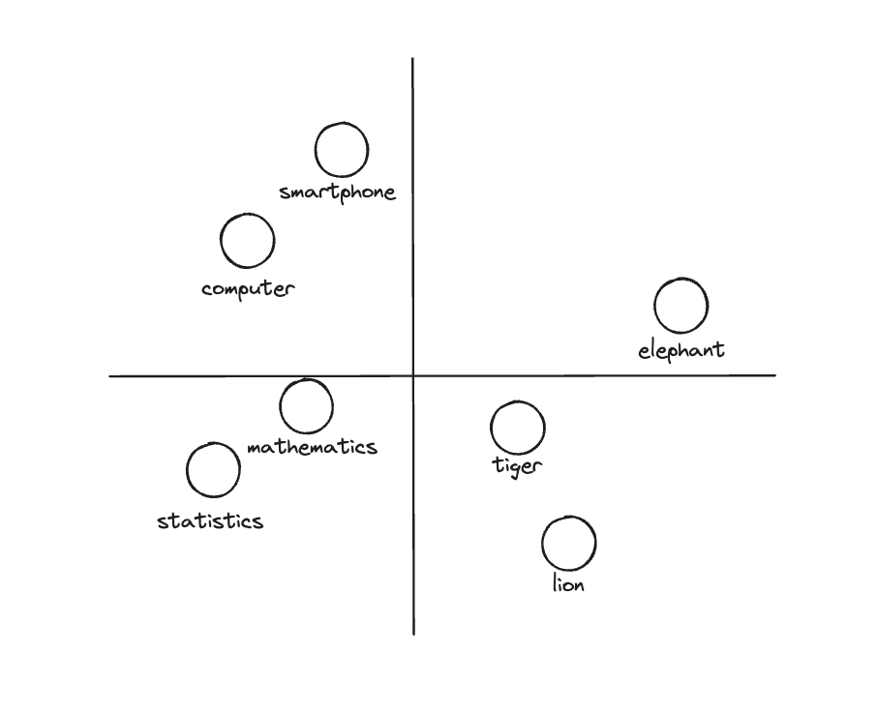

Slide 21
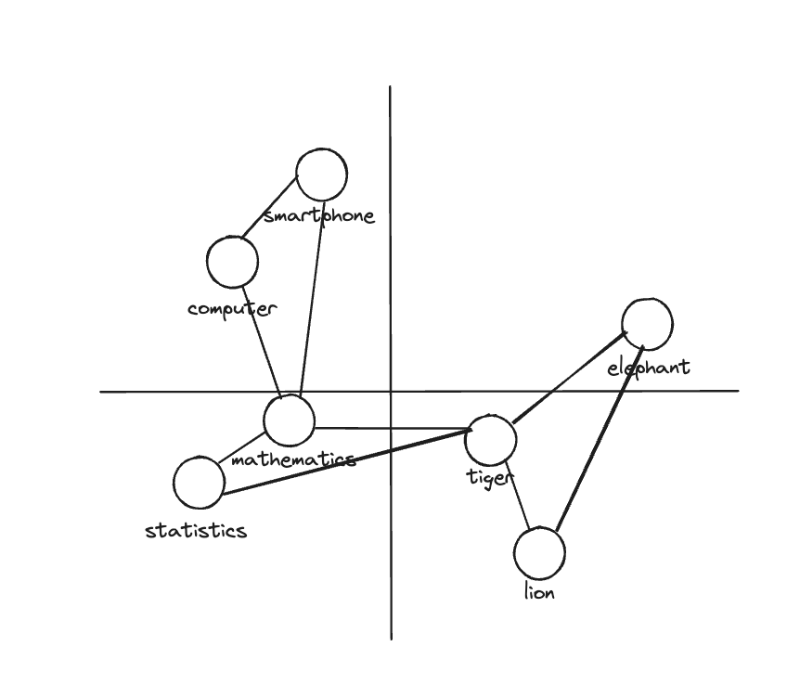

Slide 22
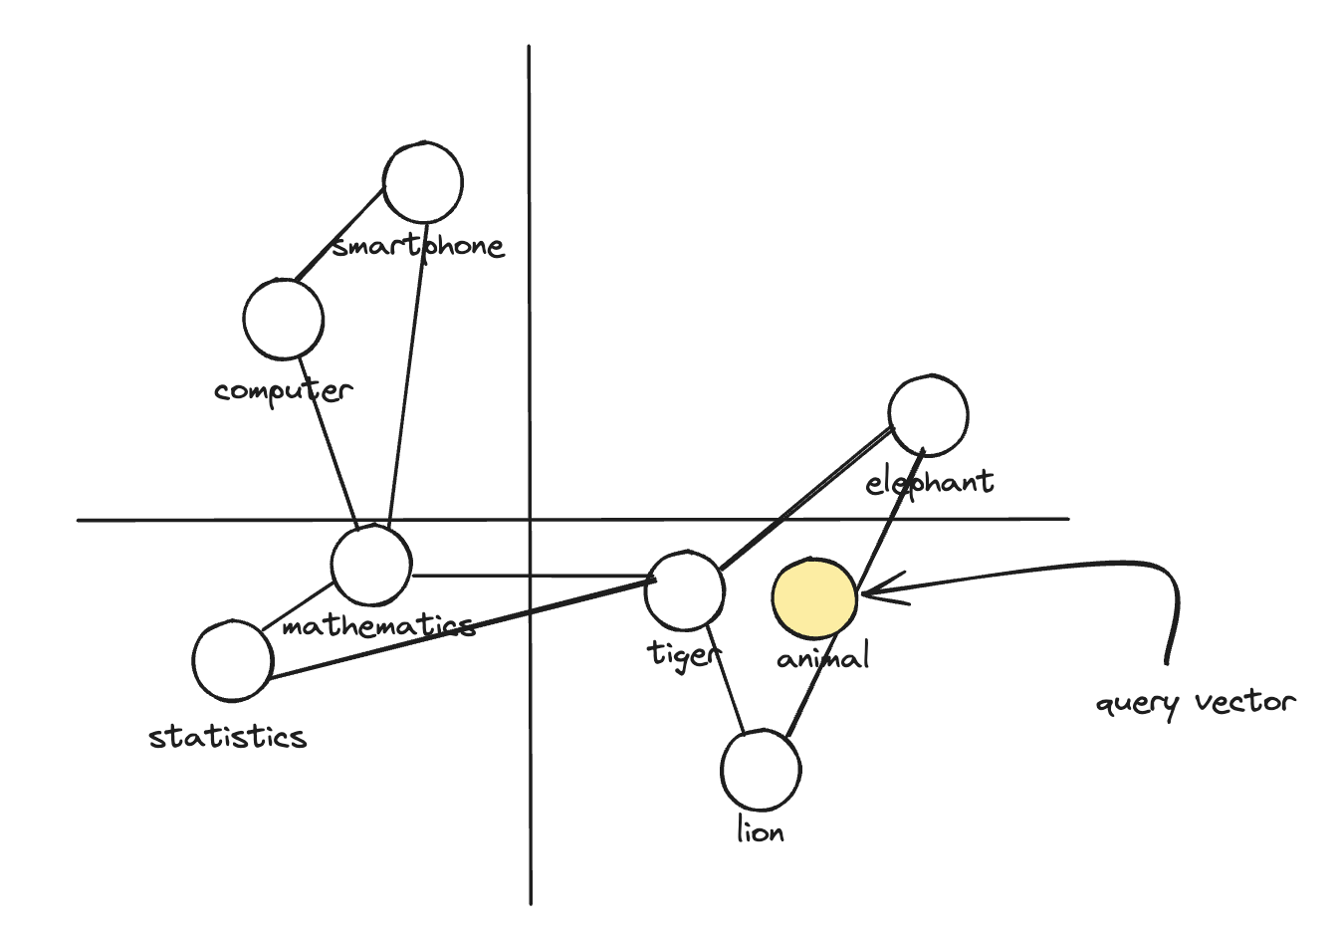

Slide 23
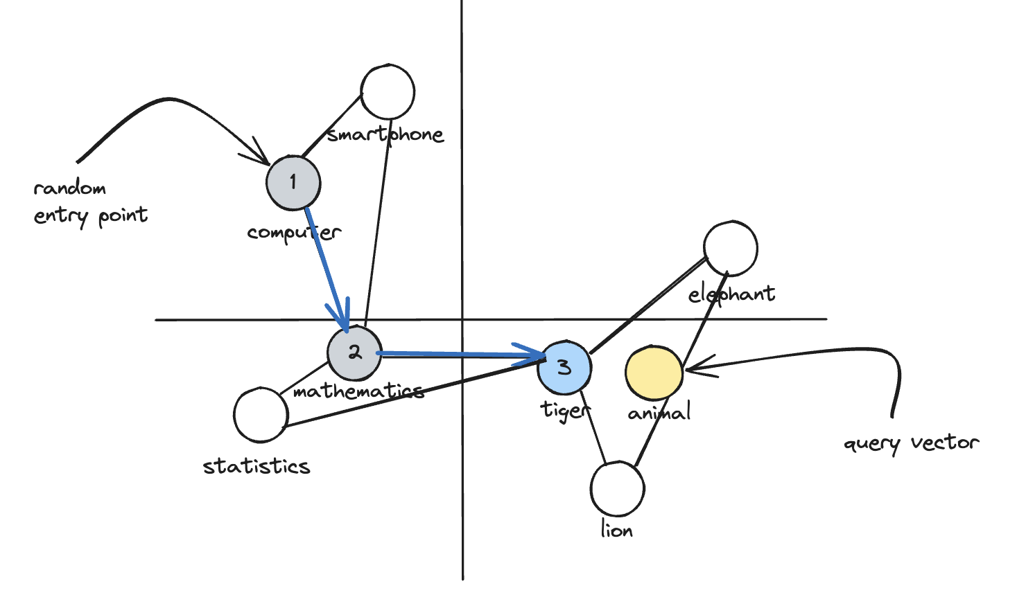

Slide 24
Drawbacks
Can get stuck in local minimum
Polylogarithmic complexity, not performant at scale
Searches for multiple nodes, multiple times

Slide 25
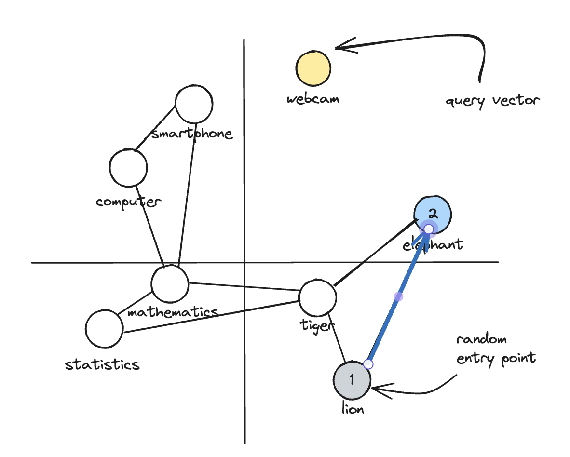

Slide 26
Hierarchical NSW
Multi-layered graph
Base layer has all nodes (dense), more connections
Higher layer have fewer nodes (sparse) and fewer connections
Search starts in top layer descending towards bottom layers

Slide 27
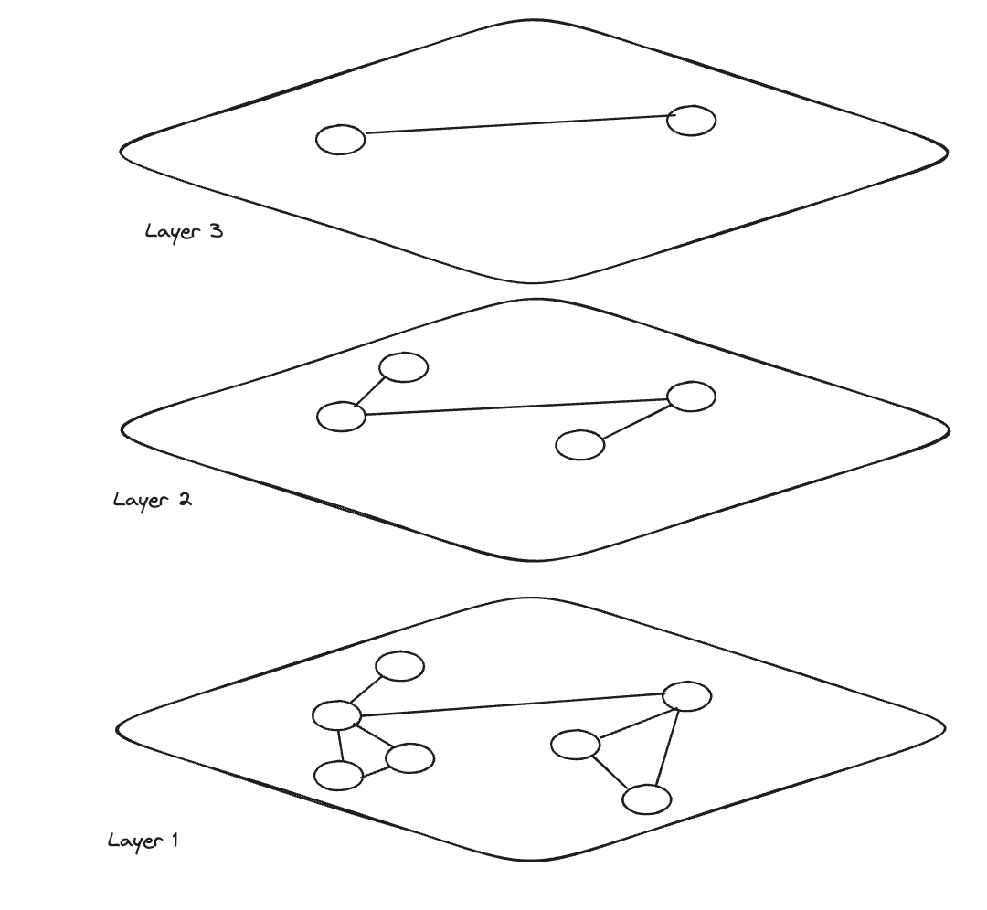

Slide 28
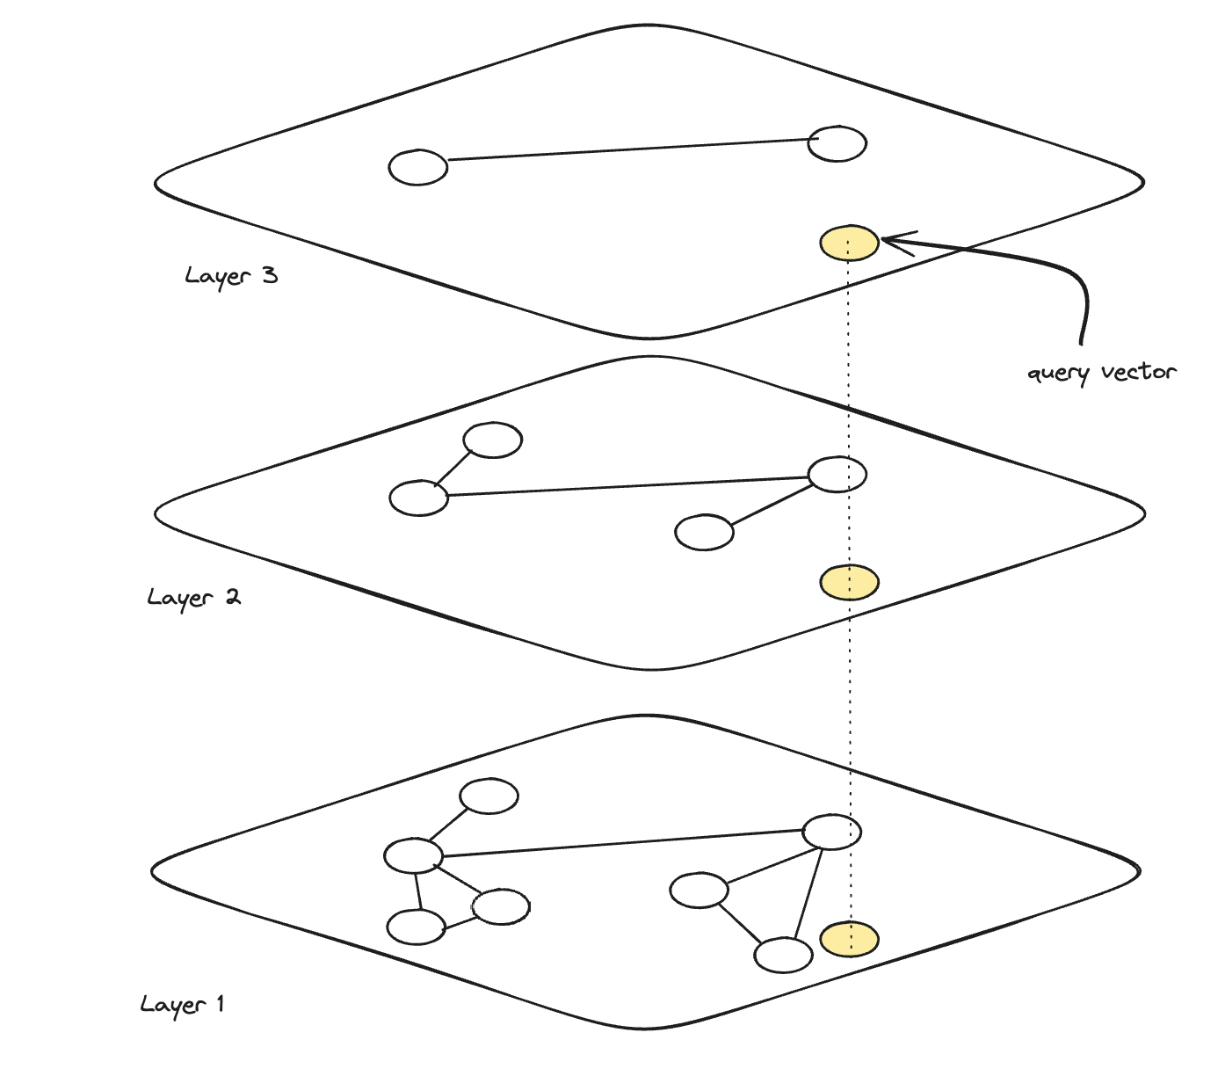

Slide 29
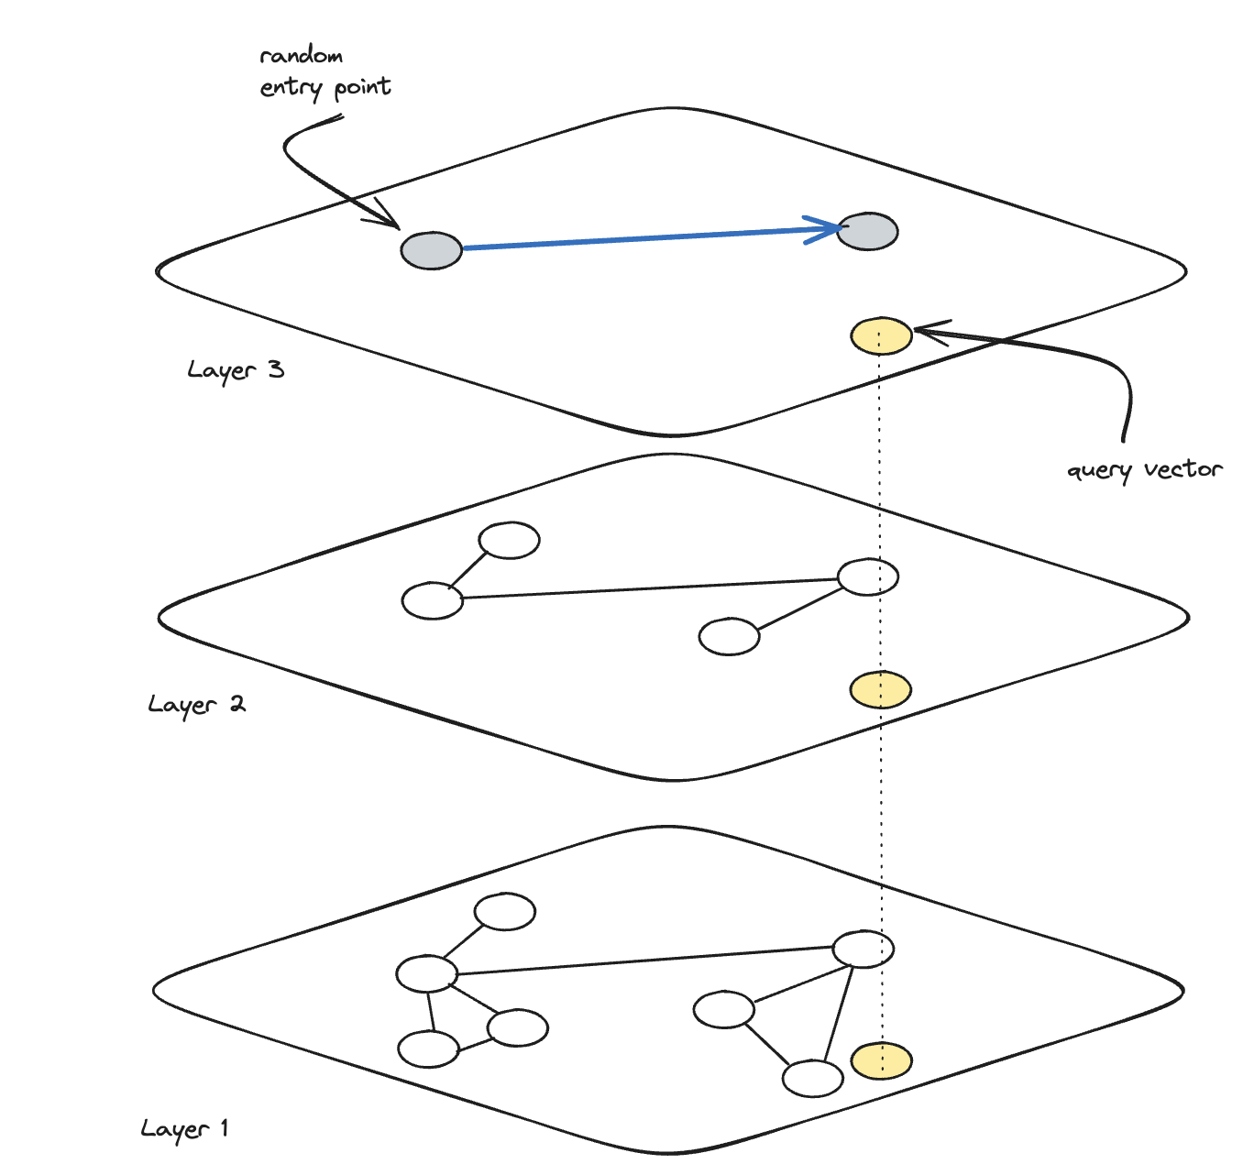

Slide 30
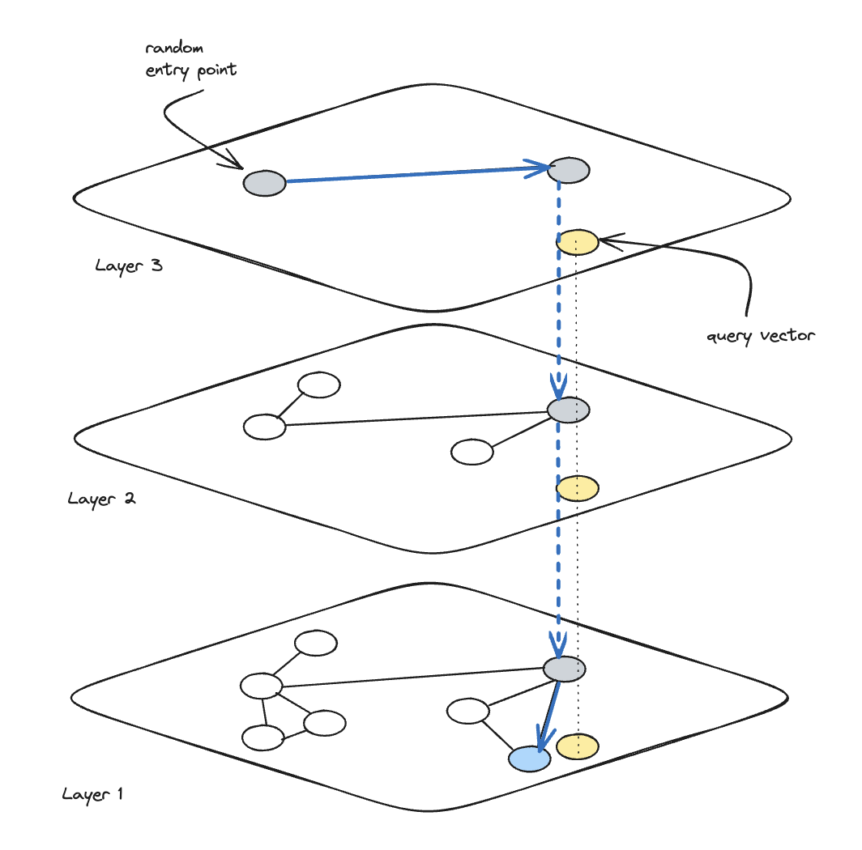

Slide 31
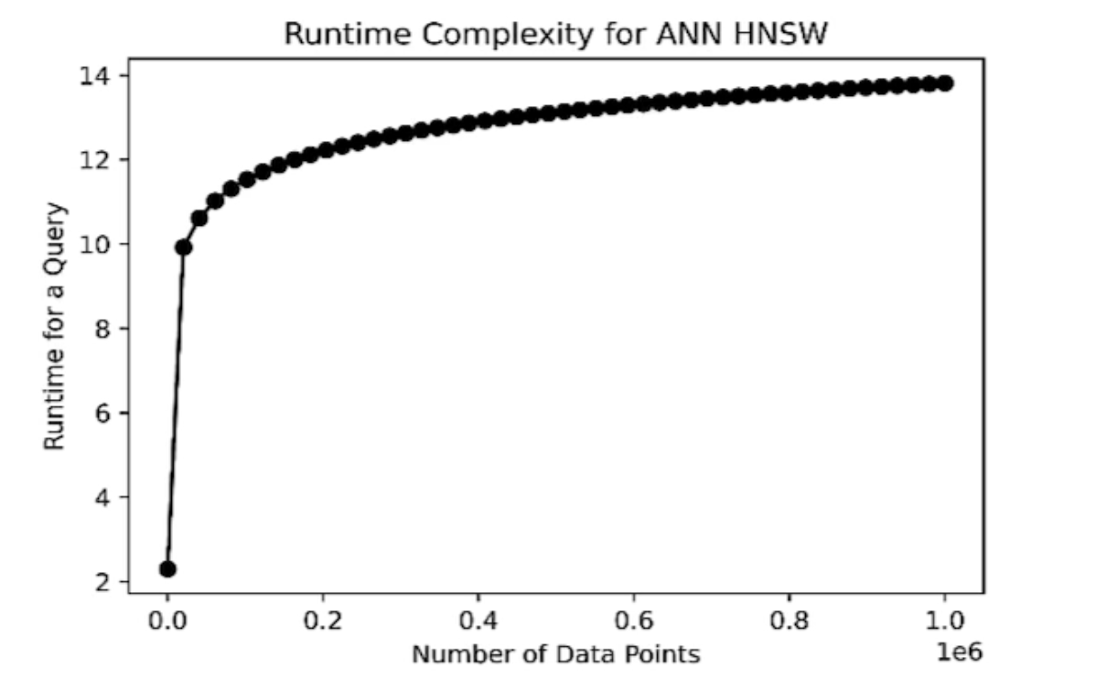
Performance
Ensures consistent, reliable performance
Query time increases logarithmically
Typical query latency ~milliseconds

